Slide 1
Bee
Handler
By Brian McNamee

Slide 2
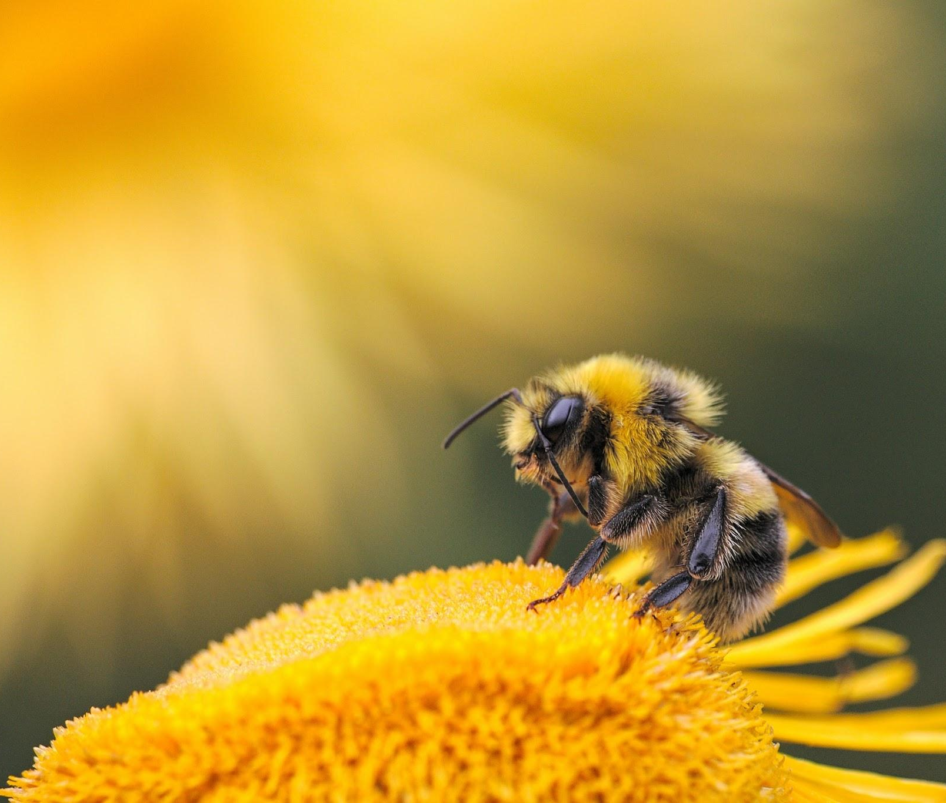
What is it?
Inspired by Slime Rancher, Bee handler is a first-person collector game, where the objective is to collect and combine types of bees and then sell their wax and honey to the world.

Slide 3
Target Audience
PC, PlayStation and Xbox ports.
Casual gamers that enjoy playing relaxing games. Collectors will also enjoy.
All genders, teenagers to young adults.
People with lower income can buy the game at a market price of $25.

Slide 4
Setting/genre.
Cute, explorative world with couch co-op.
Cute cartoony art style.
You are a beekeeper on an island with a variety of unique bees. Collect and farm the bees to sell their honey and wax.

Slide 5
Mechanics
Collecting bees to build up a farm and collect money via the wax and honey the bees produce. Combine different types of bees and foods.
Unlock new bees and areas to expand the farm.
Upgrade bee suit to allow easier traversal across the world.

Slide 6
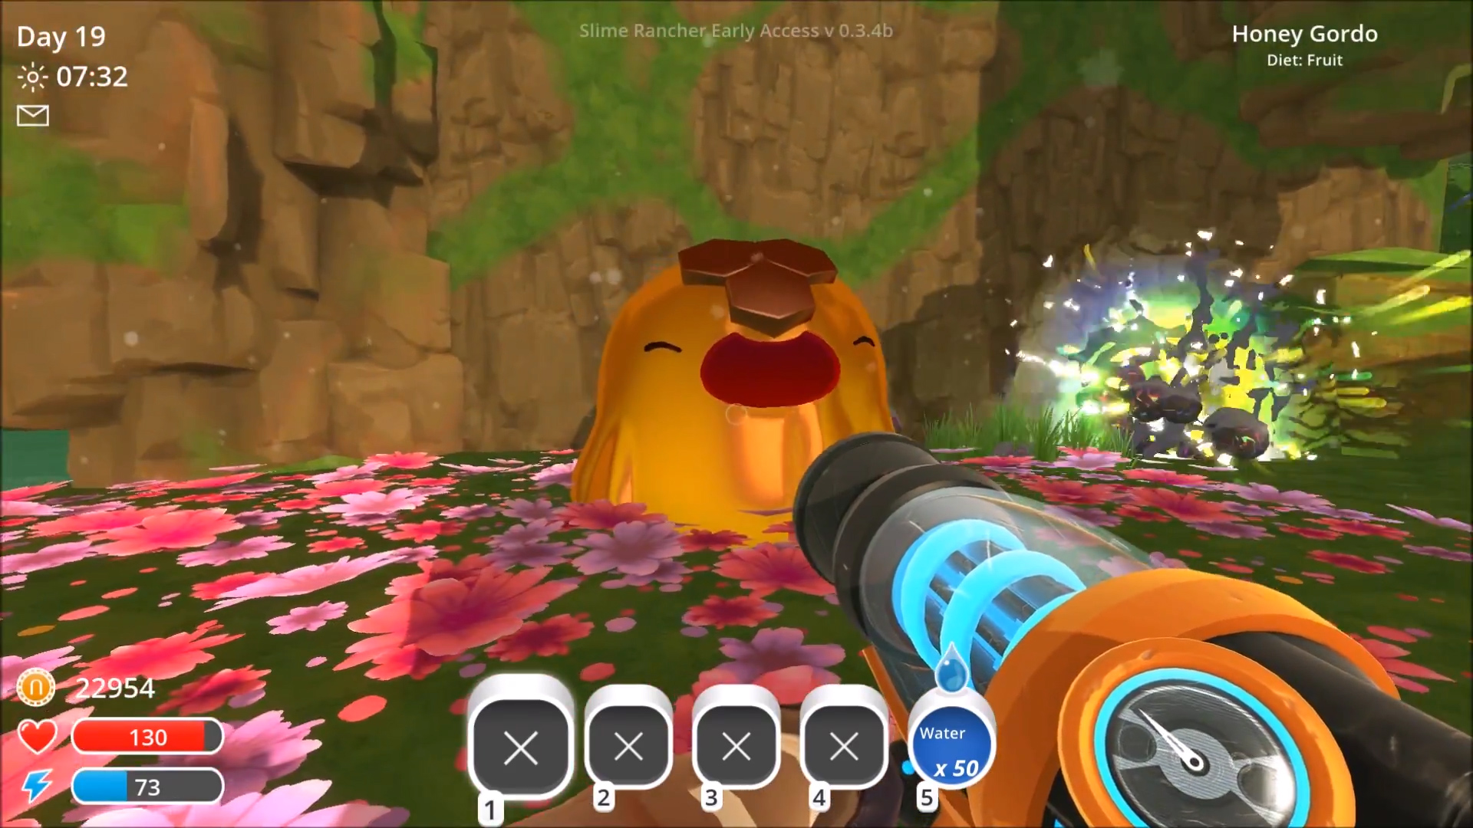
Prototype
Artists.
Concept art of Bee fusions in progress.
Art bible first draft.
Programmers.
Technical design document first draft.
Code for AI Behaviour active in game.
Couch co-op code.
Screenshot from the game Slime Rancher.
Designers.
Game design document first draft.
First level concept done.
Playable grey box.

Slide 7
Questions for QA
Is this a relaxing game to play?
How does the gameplay feel? Is collecting the bees/food repetitive?
What do you believe could help the game flourish?

Slide 8
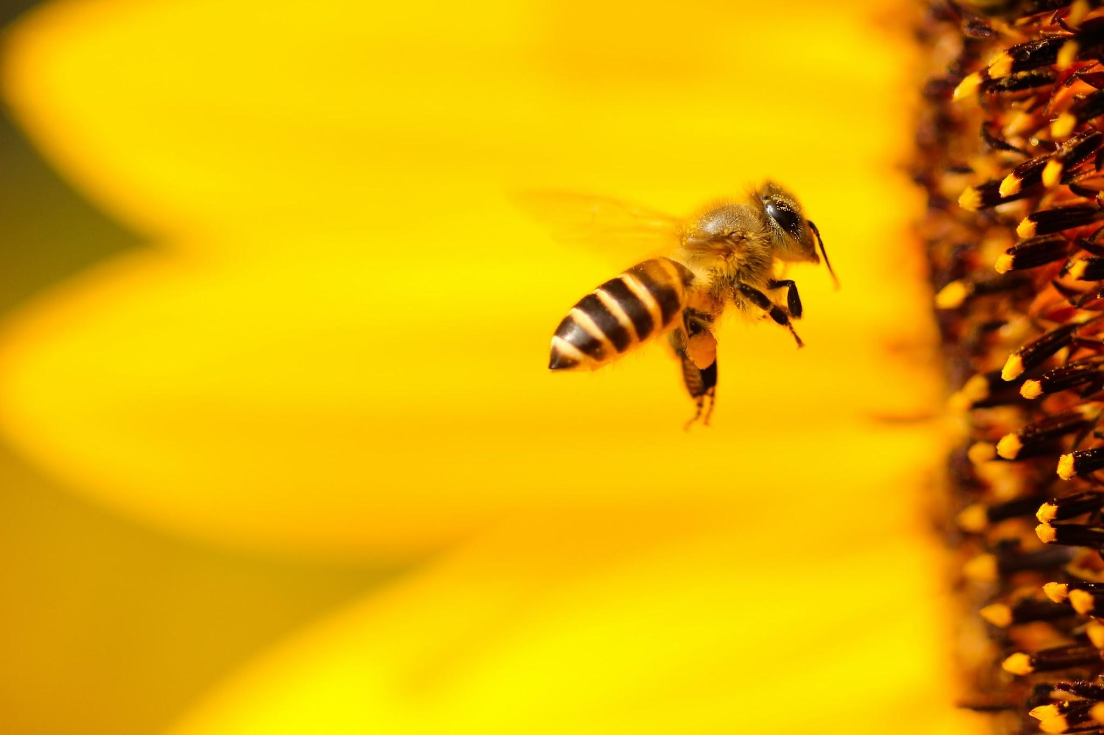
Any questions?
BEE AWESOME!

